Slide 1
Blockchain Visualisation Web Application
Play by Play

Slide 2
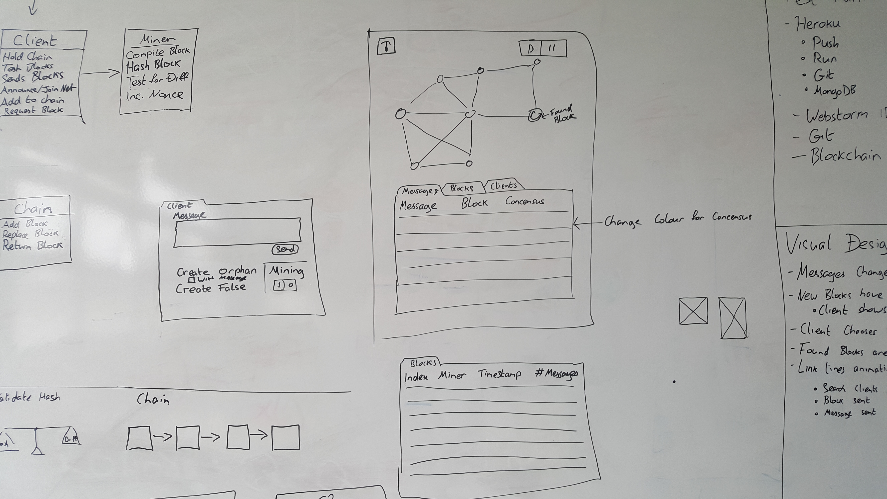
Play by Play
Need to Know
Test Run
Consideration
Visual Design

Slide 3
Need to Know
Blockchain Technical
Who calculates the difficulty
How clients communicate
How the blockchain updates new clients
Hash type used
Full Block Format
Software Costs
Node vs. JavaScript differences and features

Slide 4
Test Run
Heroku
Mongo
WebStorm
Git
Blockchain

Slide 5
Consideration
Format depends on language used
Three fields of development
Technical
UI
Visual Design
Remember:
Imitation/Emulation/Simulation
Don’t call clients nodes

Slide 6
Visual Design
New blocks:
Pulse
Random colour
Clients:
Current block colour
Random position
Message Colour shows consensus
Link Lines Animation

Slide 7
Thank You

